Slide 1

Cardiovascular Disease
PRESENTED BY:
CHING-YAO YANG
DENNIS MANDERE
NAZIA NAZRUL NASHITA
MOHAMMED AFEEF SHAIK

Slide 2
List of Content
Application
Data description
Models
Evaluation
Results and Value
References

Slide 3
What is CVD
Heart Disease:
Cardiovascular disease (CVD) is a general term that describes a disease of the heart or blood vessels.
Blood flow to the heart, brain or body can be reduced because of:
Blood clot (Thrombosis)
Build-up of fatty deposits inside an artery, leading to the artery
hardening and narrowing (Atherosclerosis)

Slide 4
AI application
Medical image analysis: Analyze medical images such as echocardiograms, MRIs, and CT scans to identify signs of cardiovascular disease.
Electrocardiogram (ECG) analysis: Analyze ECG data to detect abnormalities in heart rhythms that may indicate cardiovascular disease.
Personalized medicine: Develop personalized treatment plans for patients with cardiovascular disease, taking into account individual patient characteristics and medical history.
Genomic analysis: Analyze genetic data to identify genetic variants associated with increased risk of cardiovascular disease.

Slide 5
Data Description
The dataset consists of 70,000 records of patients data, 12 features + target.
There are 3 types of input features:
Objective: Factual information
Examination: Results of medical examination
Subjective: Information given by the patient

Slide 6
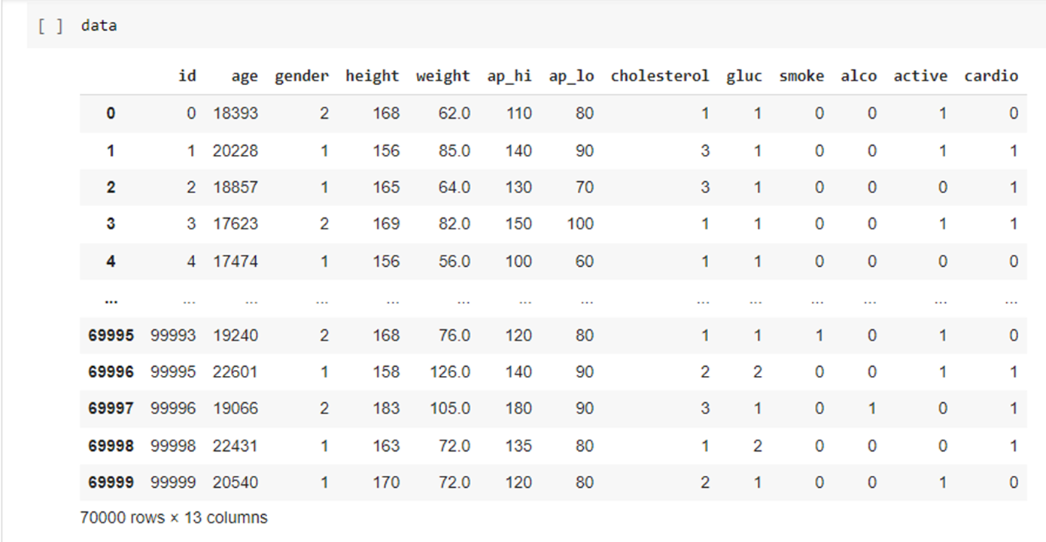
Data Snapshot

Slide 7
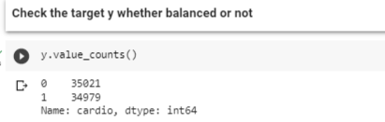
Data Description
Features:
1. Id 7. ap_lo
2. age 8. cholesterol
3. gender 9. gluc
4. height 10. smoke
5. weight 11. alco
6. ap_hi 12. active
13. cardio
1 Normal
2 Above Normal
3 Well above Normal
Target

Slide 8

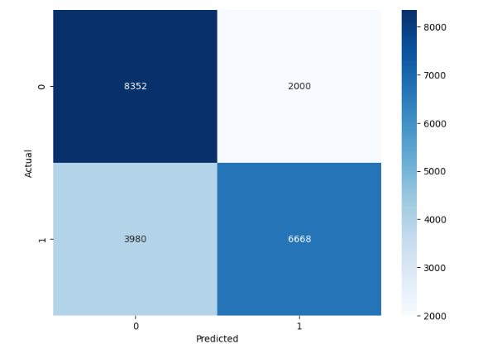
Model
Entropy Apply
True Negative
False Positive
Decision Tree
False Negative
True Positive

Slide 9
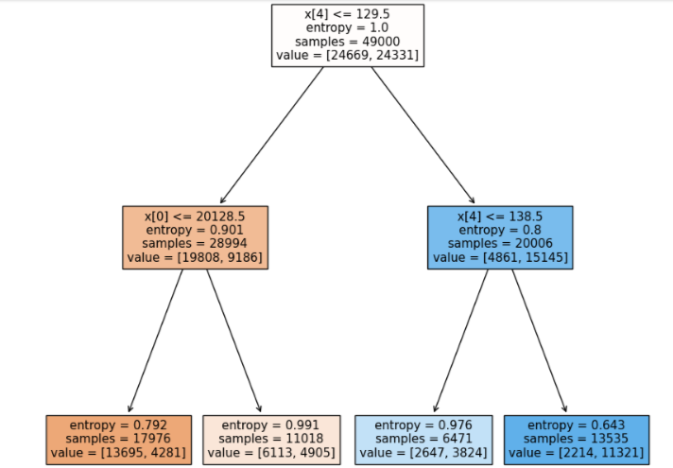
Drop the data

Slide 10
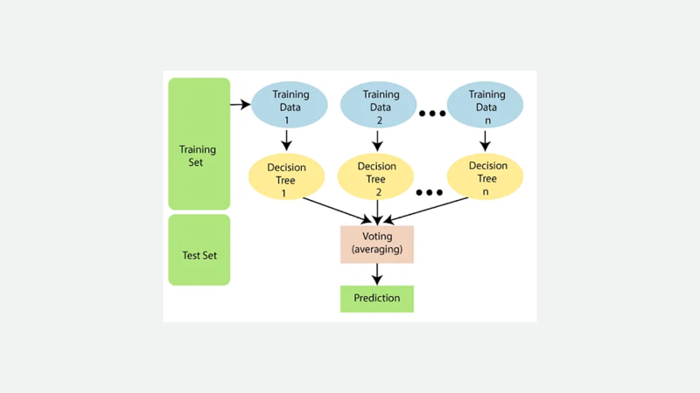
Random Forest

Slide 11

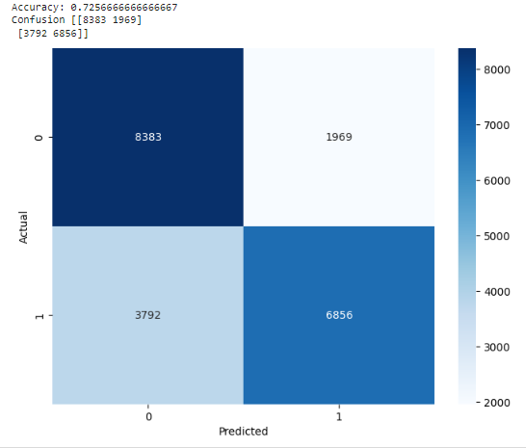
Model
Random Forest

Slide 12
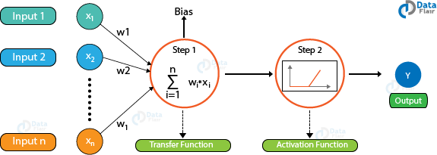
Model
Neural Network

Slide 13
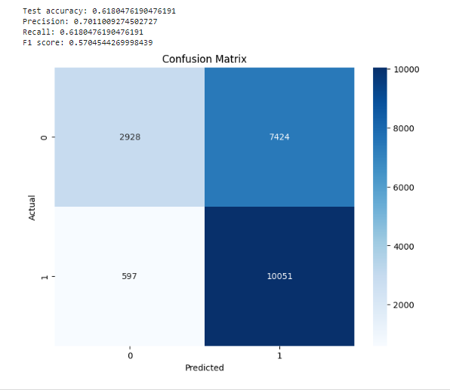
Model
Neural Networks

Slide 14
Model: Neural Network
Model accuracy: 0.6180, meaning the model correctly classified 61.80% of instances in the dataset.
Precision: 0.7011, indicating that out of all the instances predicted to have cardiovascular disease, only 70.11% of them were actually true positives.
Recall: 0.6180, which means that out of all the true positive instances in the dataset, the model correctly identified 61.80% of them as positive for cardiovascular disease.
F1 score: 0.5704, a balanced evaluation of the model's precision and recall performance.
Confusion matrix: the model correctly classified 10051 instances as True Negatives and 2928 instances as True Positives, but also incorrectly classified 597 instances as false negatives and 7424 instances as false positives.

Slide 15
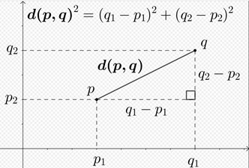
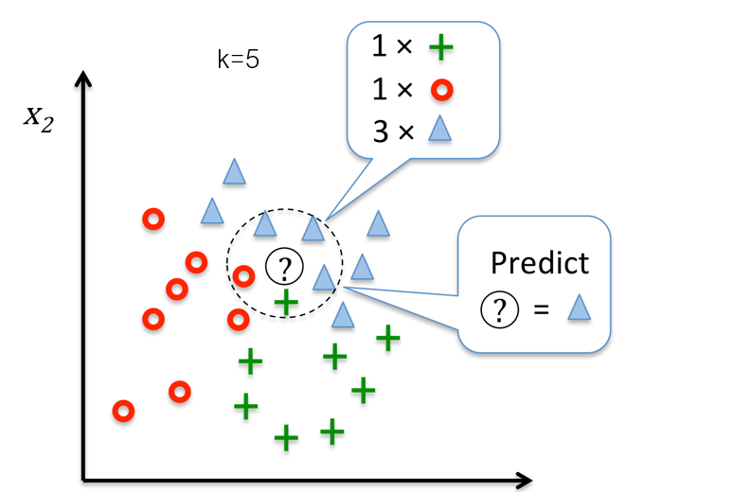




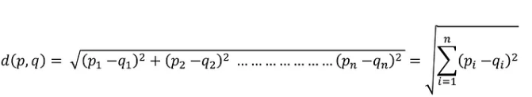
K-NN Regression
id
age
Glucose
Cholesterol
scaling
Normalization
Cardio
Gender
Height
Weight
Standerdization
K=5 (3~7)
Ap hi
Ap low
Smoke
Alcohol
Activity
n=12
Notes:
15

Slide 16
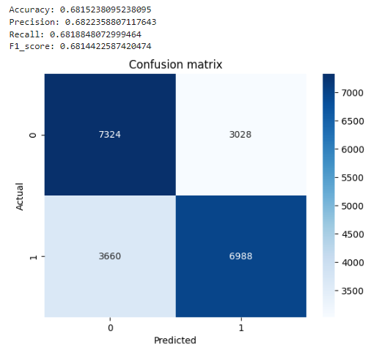
Model
K- Nearest Neighbor

Slide 17
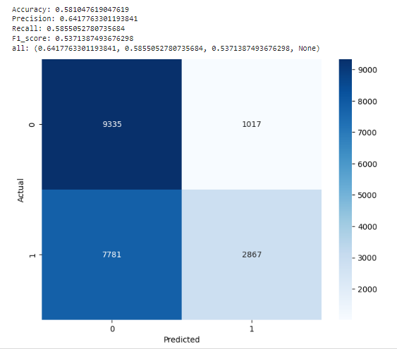
Model
Naïve Bayes

Slide 18
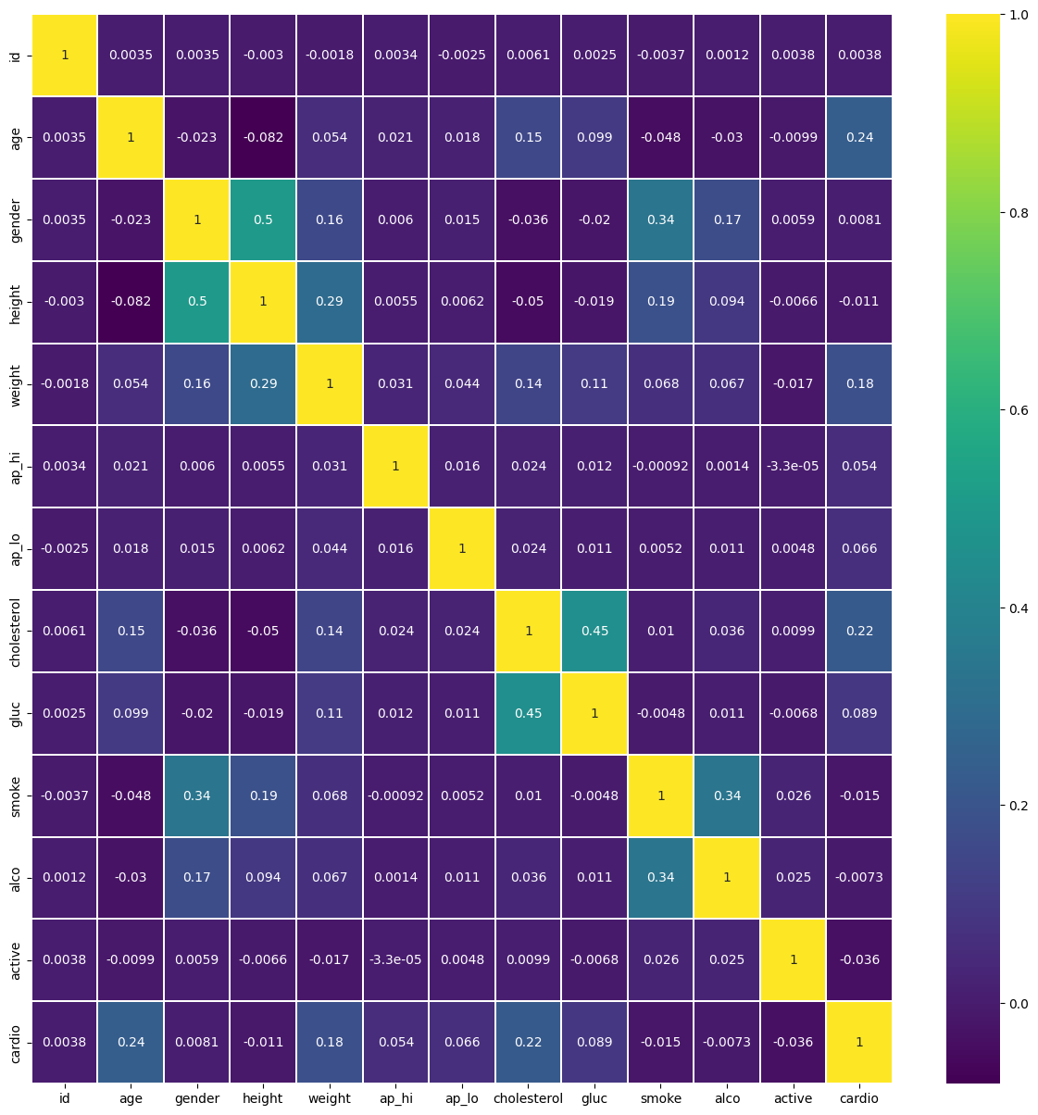
C O R R E L A T I O N M A T R I X

Slide 19
Evaluation and Result
 | Accuracy | Precision | Recall | F1_score
Decision Tree | 0.7152380952380952 | 0.7692662667281956 | 0.626220886551465 | 0.6904120936011596
Random Forest | 0.7327129735735352 | 0.7268359965139922 | 0.7268359965139922 | 0.7242084554595015
KNN | 0.6815238095238095 | 0.6822358807117643 | 0.68188488072999464 | 0.6814422587420474
NN | 0.6180476190476191 | 0.7011009274502727 | 0.6180476190476191 | 0.5704544269998439
Naïve Bayes | 0.5855052780735684 | 0.6417763301193841 | 0.5855052780735684 | 0.5371387493676298
Random Forest wins!

Slide 20
What is a leading cause of death worldwide?
Cardiovascular disease (CVD) is indeed a leading cause of death worldwide.
According to the World Health Organization (WHO), CVDs were responsible for an estimated 17.9 million deaths in 2019, accounting for 32% of all global deaths.
In contrast, cancer was responsible for an estimated 9.6 million deaths in the same year, accounting for 17% of all global deaths.
(World Health Organization: WHO, 2021)
(World Health Organization: WHO, 2019a)

Slide 21
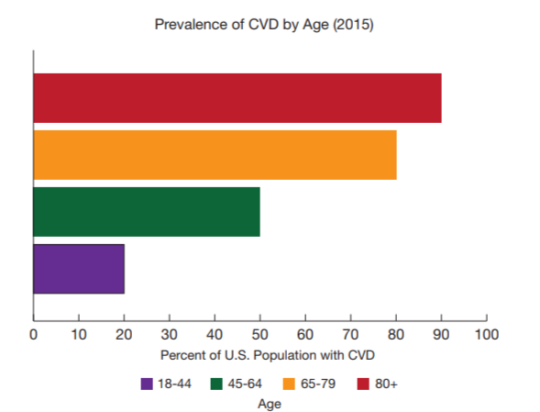
U.S. Population with CVD
(CARDIOVASCULAR DISEASE: A COSTLY BURDEN FOR AMERICA PROJECTIONS THROUGH 2035, 2017)

Slide 22
Costs of CVD in U.S.?
(CARDIOVASCULAR DISEASE: A COSTLY BURDEN FOR AMERICA PROJECTIONS THROUGH 2035, 2017)
“In 2016, CVD cost America $555 billion. By 2035, the cost will skyrocket to $1.1 trillion.”
Cardiovascular disease not only exacts a heavy toll on the health of Americans, its economic burden is enormous. It is America’s costliest disease, and it will soar in the coming decades.

Slide 23
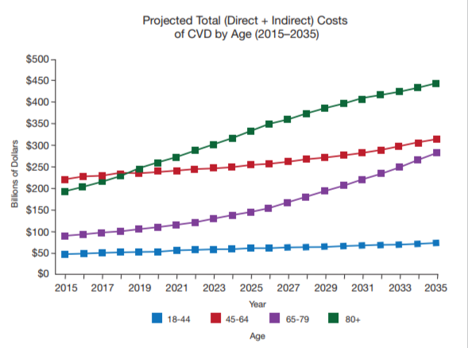
Costs of CVD
(CARDIOVASCULAR DISEASE: A COSTLY BURDEN FOR AMERICA PROJECTIONS THROUGH 2035, 2017)

Slide 24
Using AI in CVD is useful?
Artificial intelligence (AI) has the potential to revolutionize the prevention, diagnosis, and management of CVD in a number of ways.
Risk prediction and prevention: AI can help predict an individual's risk of developing CVD by analyzing large amounts of patient data which is highly valuable in research institutions.
Treatment planning: AI can help healthcare providers develop personalized treatment plans for patients with CVD based on their individual characteristics, such as their age, sex, and medical history.

Slide 25
Example
Journal of the American College of Cardiology in 2019 found that a machine learning algorithm was able to accurately predict cardiovascular events.
Using ML could result in a 1.6% reduction in CVD over a five-year period, leading to a potential cost savings of $2.1 billion in the U.S. alone.
Attia et al. (2019)

Slide 26
References
World Health Organization: WHO. (2021, June 11). Cardiovascular diseases (CVDs). www.who.int. Retrieved April 21, 2023, from https://www.who.int/news-room/fact-sheets/detail/cardiovascular-diseases-(cvds)
World Health Organization: WHO. (2019a). Cancer. www.who.int. https://www.who.int/health-topics/cancer#tab=tab_1
CARDIOVASCULAR DISEASE: A COSTLY BURDEN FOR AMERICA PROJECTIONS THROUGH 2035. (2017). American Heart Association. Retrieved April 21, 2023, from https://www.heart.org/-/media/Files/About-Us/Policy-Research/Fact-Sheets/Public-Health-Advocacy-and-Research/CVD-A-Costly-Burden-for-America-Projections-Through-2035.pdf
Attia, Z. I., Kapa, S., Yao, X., Lopez-Jimenez, F., Mohan, T. L., Pellikka, P. A., Carter, R. E., Shah, N., Friedman, P. A., & Noseworthy, P. A. (2019). Prospective validation of a deep learning electrocardiogram algorithm for the detection of left ventricular systolic dysfunction. Journal of Cardiovascular Electrophysiology, 30(5), 668–674. https://doi.org/10.1111/jce.13889

Slide 27
Acknowledgement
Roles of group members:
All members identified the dataset and conducted the whole analysis procedure and we discussed on the result.
Afeef worked on the introduction.
Dennis worked on data.
Nashita worked on result and evaluation.
Ching worked on value and discussion.
The presentation was completed by all members.

